Slide 1






Slide 2


Supervision:
Dr.Samaa Shohib
EN. Mohamed ELBarbeer

Slide 3
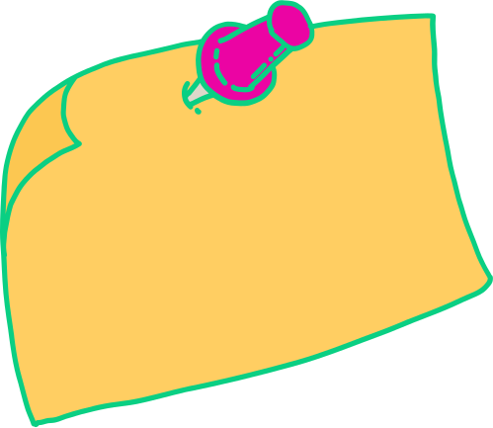

Agenda
Introduction
Proplem Overview
Project goal
Previos work
Ui
UML DIAGRAM
Soft ware archticture,ERD
Tecnologies,Tool
Model
Time Plan
Team
References

Slide 4

Intoduction
AI Virtual Try On
Idea Concept
Initial Target Audience
Expansion of Service
Online shopping platform with a realistic simulation of in-store experience.
Feature to access the camera for virtual product try-on and size measurement.
Specifically designed for people with disabilities.
Aimed to alleviate difficulties and embarrassment faced during physical try-ons
Decision to extend the feature to all users.
Response to negative statistics about online shopping experiences

Slide 5


Intoduction
FICCI stated
300 million in 2012
2.14 billion in 2020

Slide 6

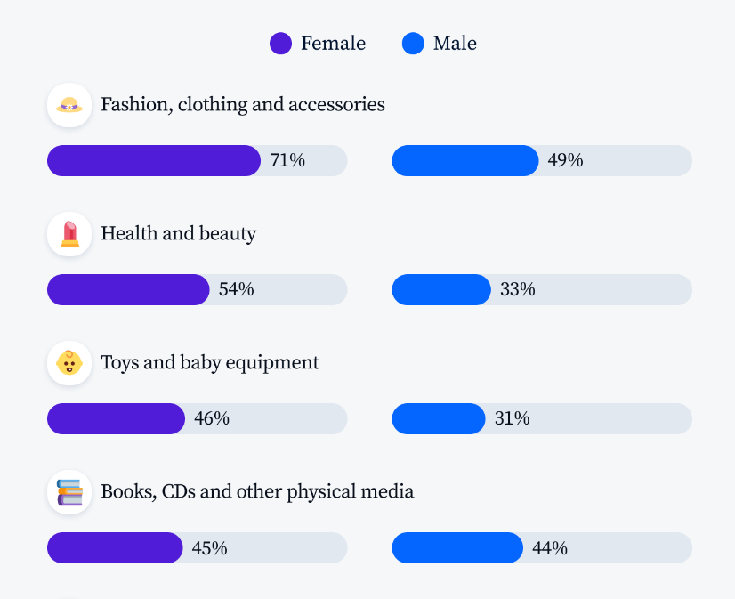



Categories of the most purchased products online appears to be clothing
World wide statistics shows that larger items purchased online is garments

Slide 7
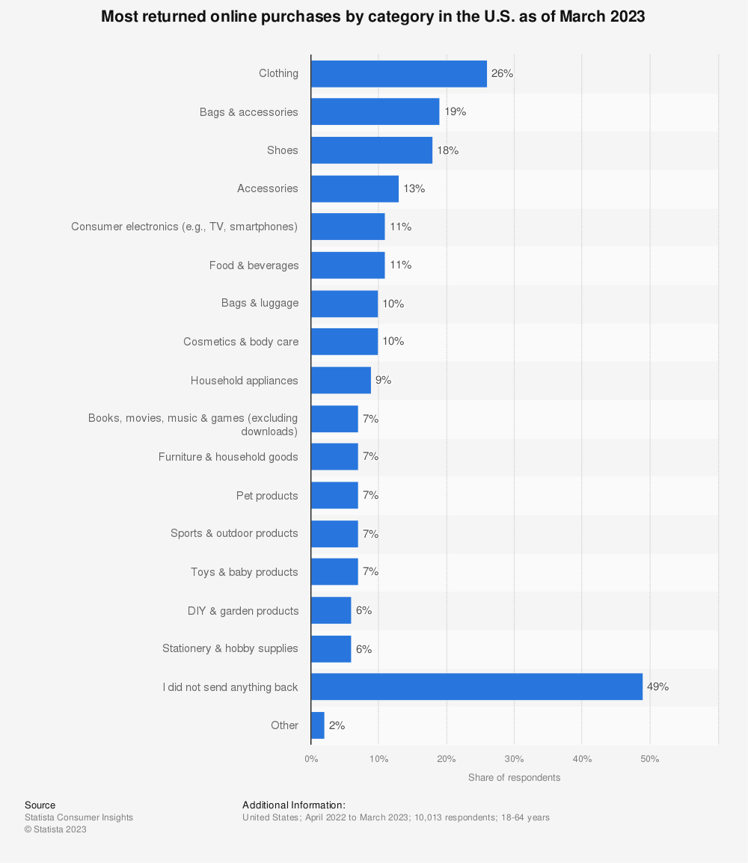
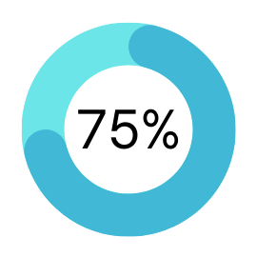
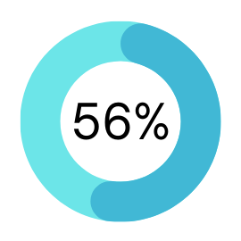
Problem overview
Item doesn’t fit
doesn’t match description

Slide 8
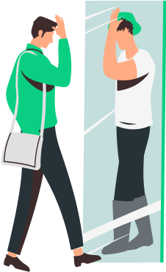
Virtual fit
Increase Confidence
Reduce Returns
Setting a New standard for
E-commerce
Boost Market

Slide 9

Why...?
1-Disabled people
16% =1.5 billion (world) 10.7%:16% =12 million ;16million (Egypt)
2- Accessibility
3- Limited options
4- Lack of Specialized products

Slide 10

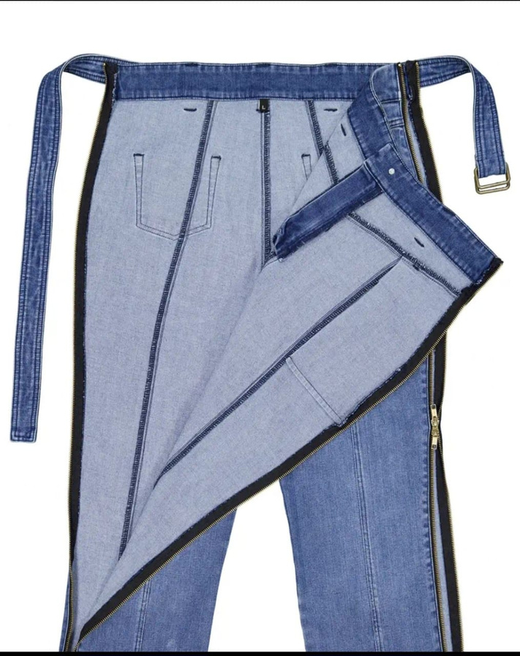
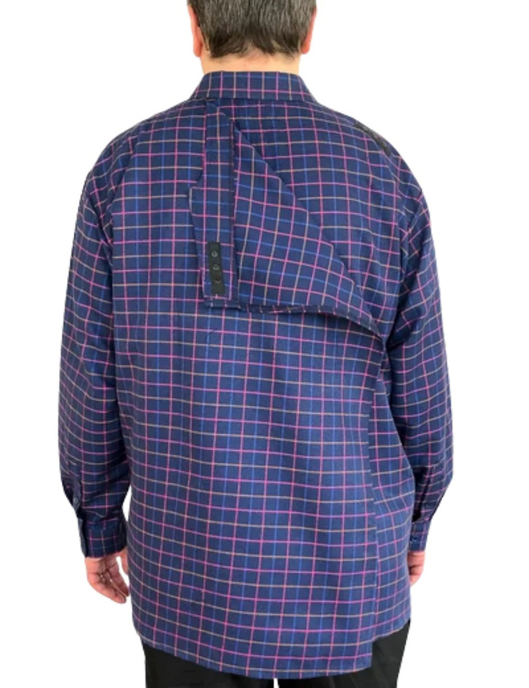
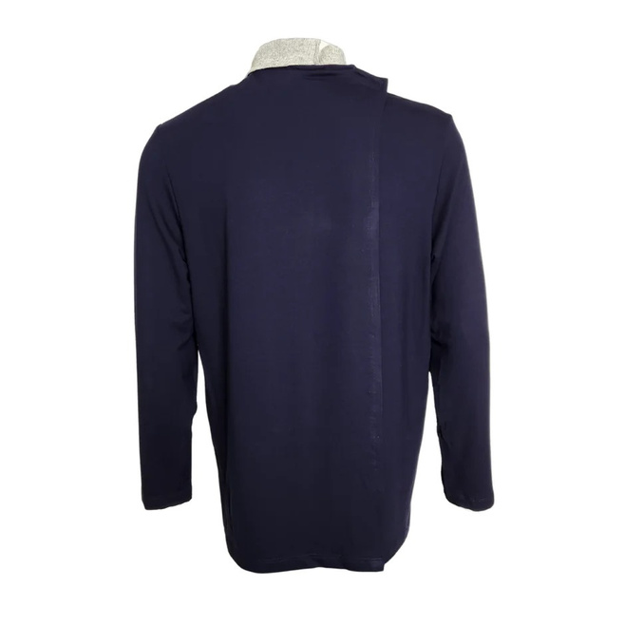
Examples of specialized Products For disabled people :

Slide 11
PROJECT
GOAL

Slide 12
project objectives:
1- Support Disability.
2- The System targets all users regardless of Living in remote areas or their physical abilities.
3- Develop virtual trials using AI models.
4- Improve technology by Integrating AI model in system.
5- Redefine online shopping .
6- Improve users interaction.
7- Reduce physical barriers and increase market reach.
8- Improve User Experience and satisfaction.
9- Provide Accessibility.

Slide 13
PREVIOS WORK

Slide 14
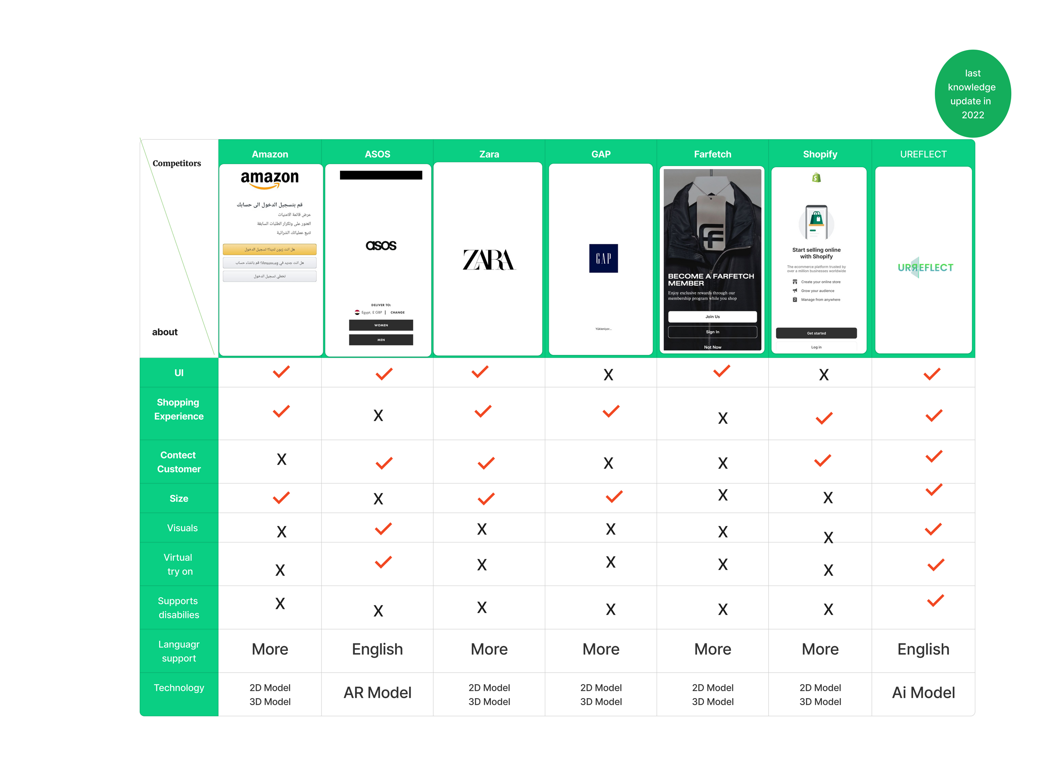
Previos work

Slide 15
MOCKUP
UI

Slide 16


Slide 17
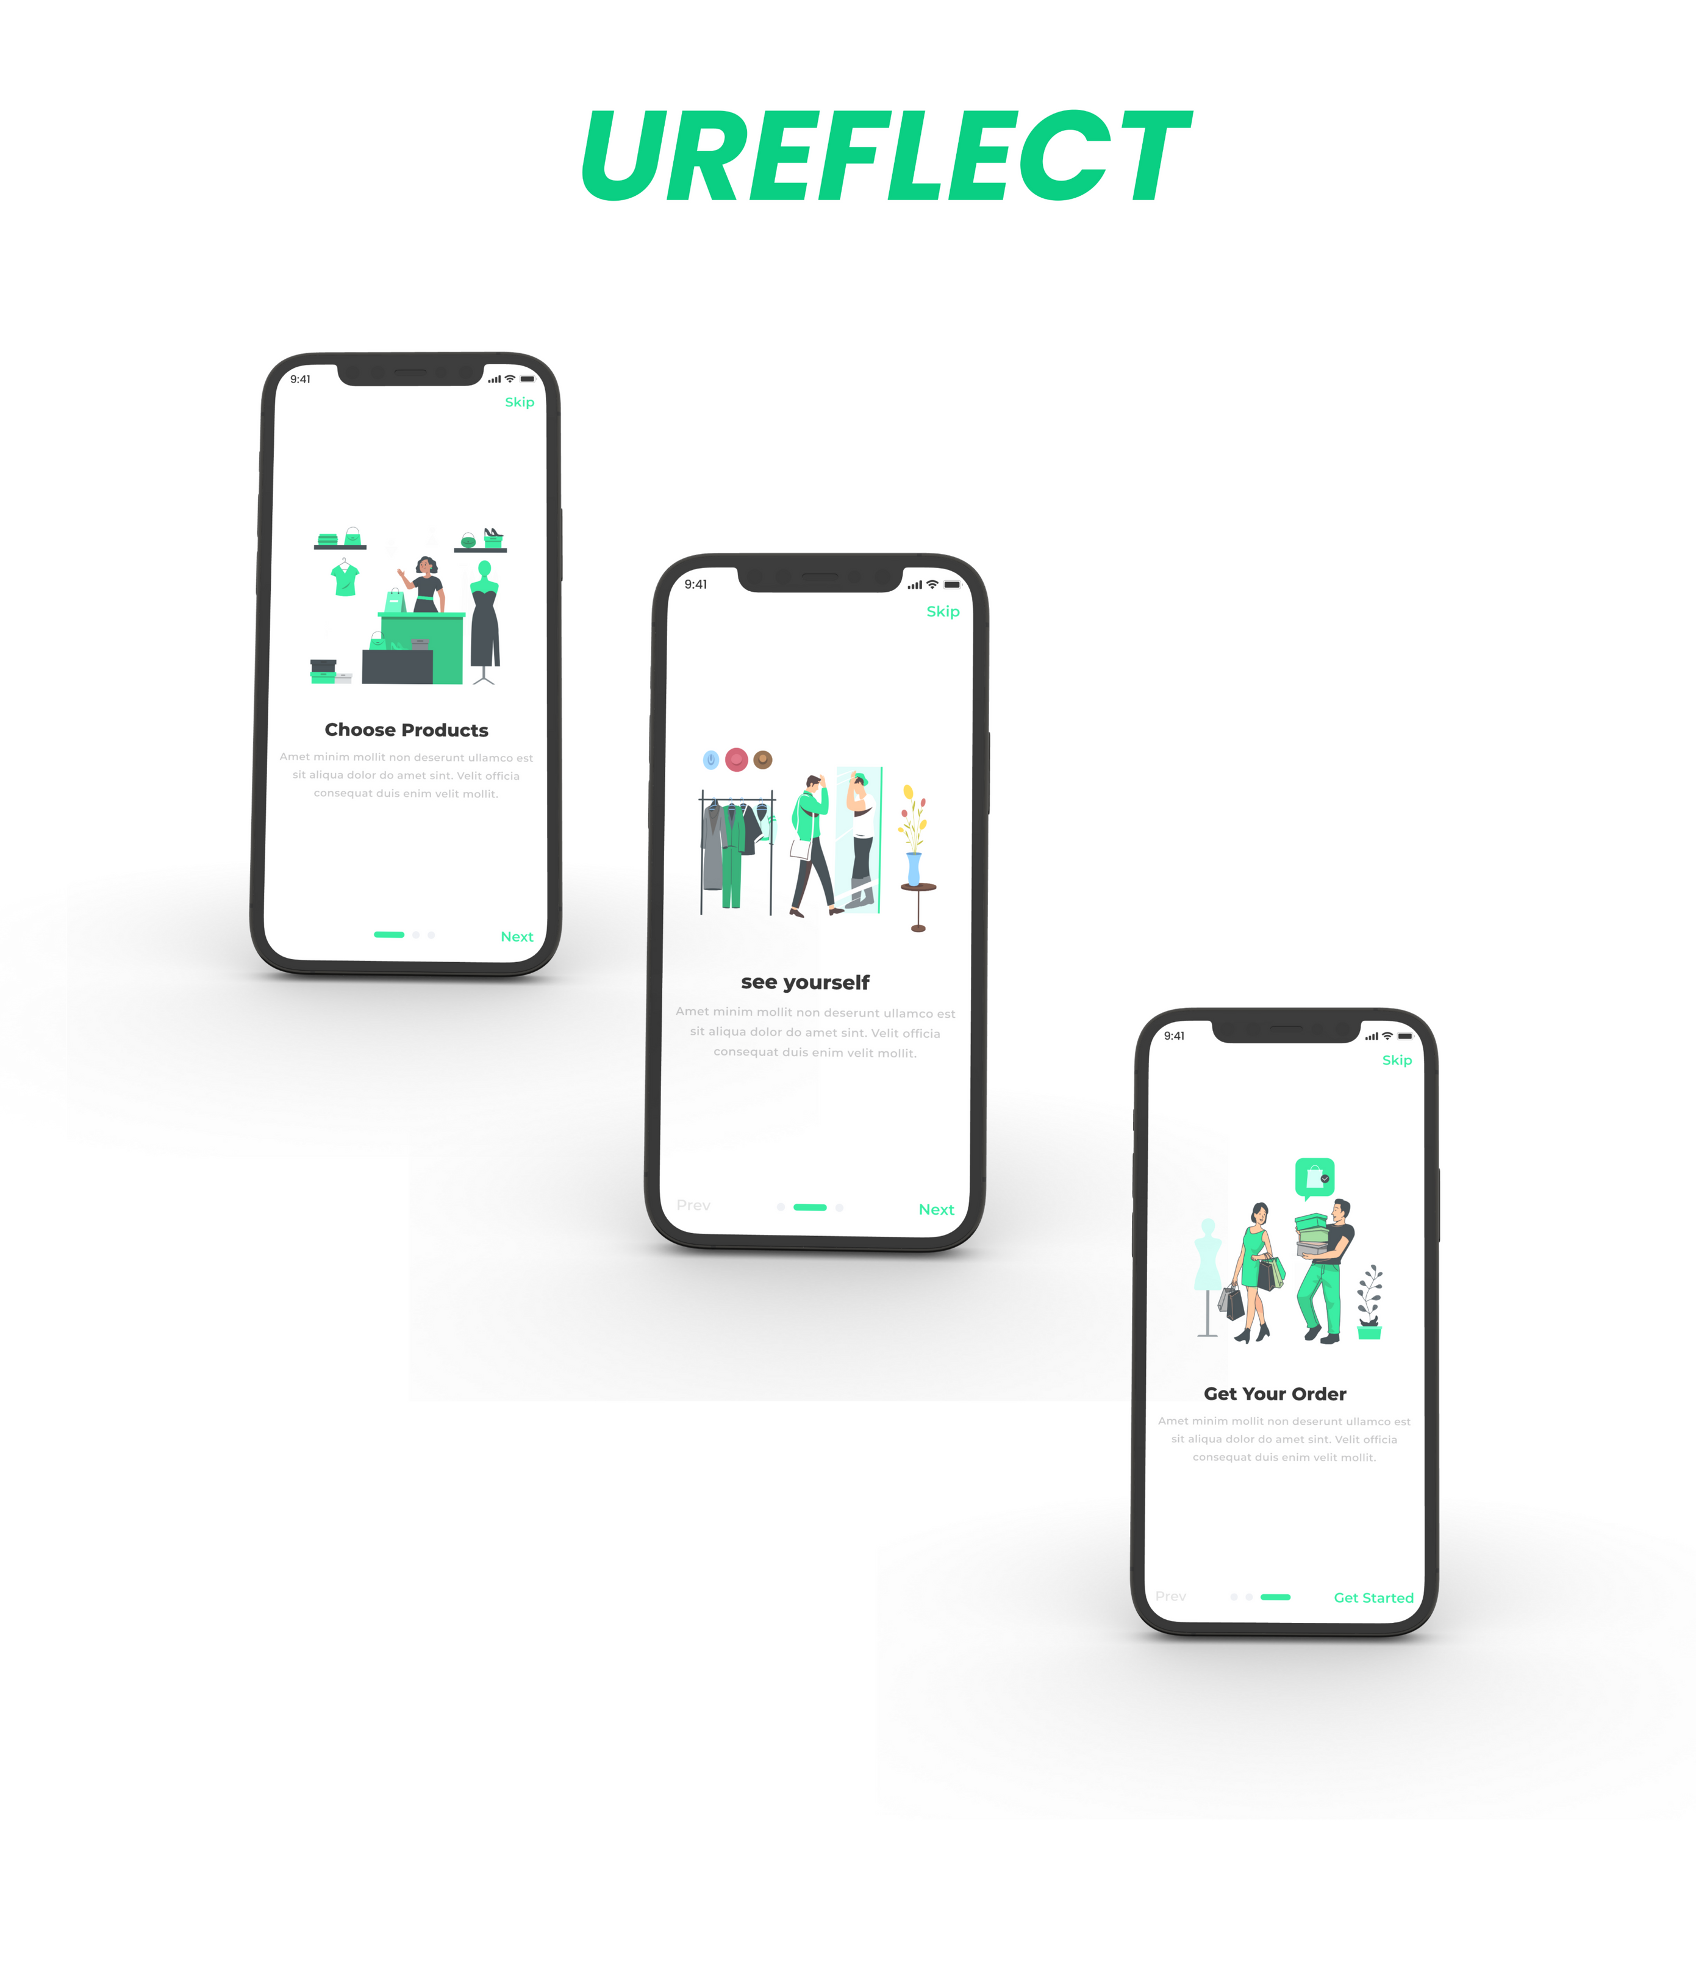

Slide 18
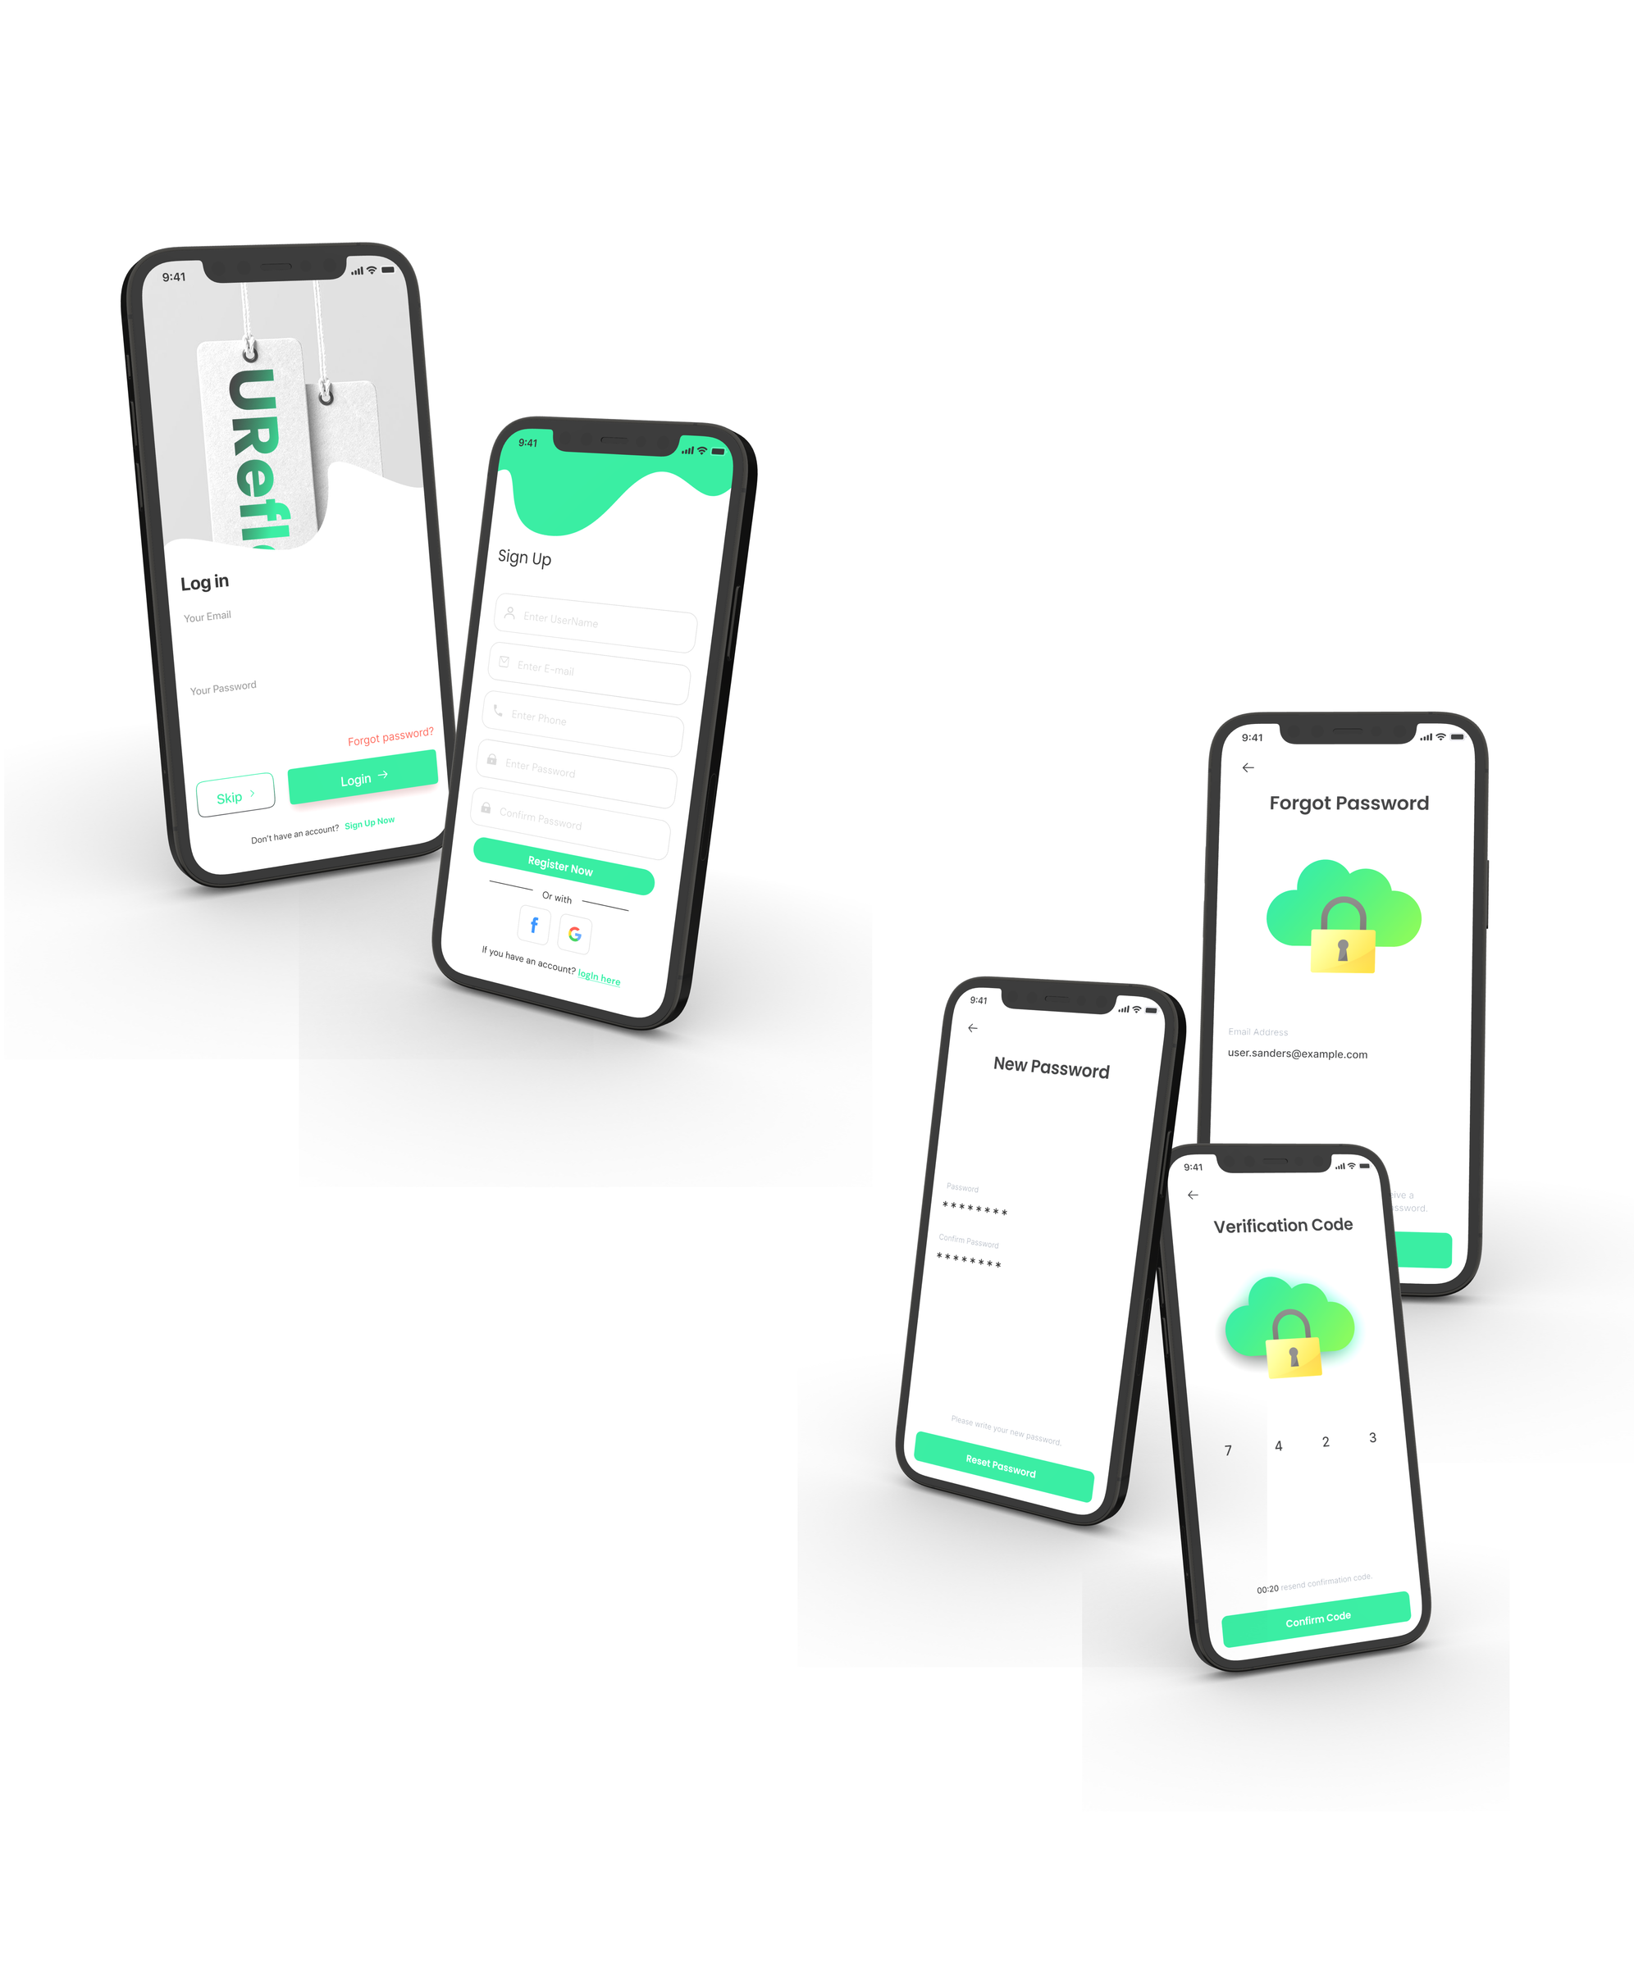

Slide 19
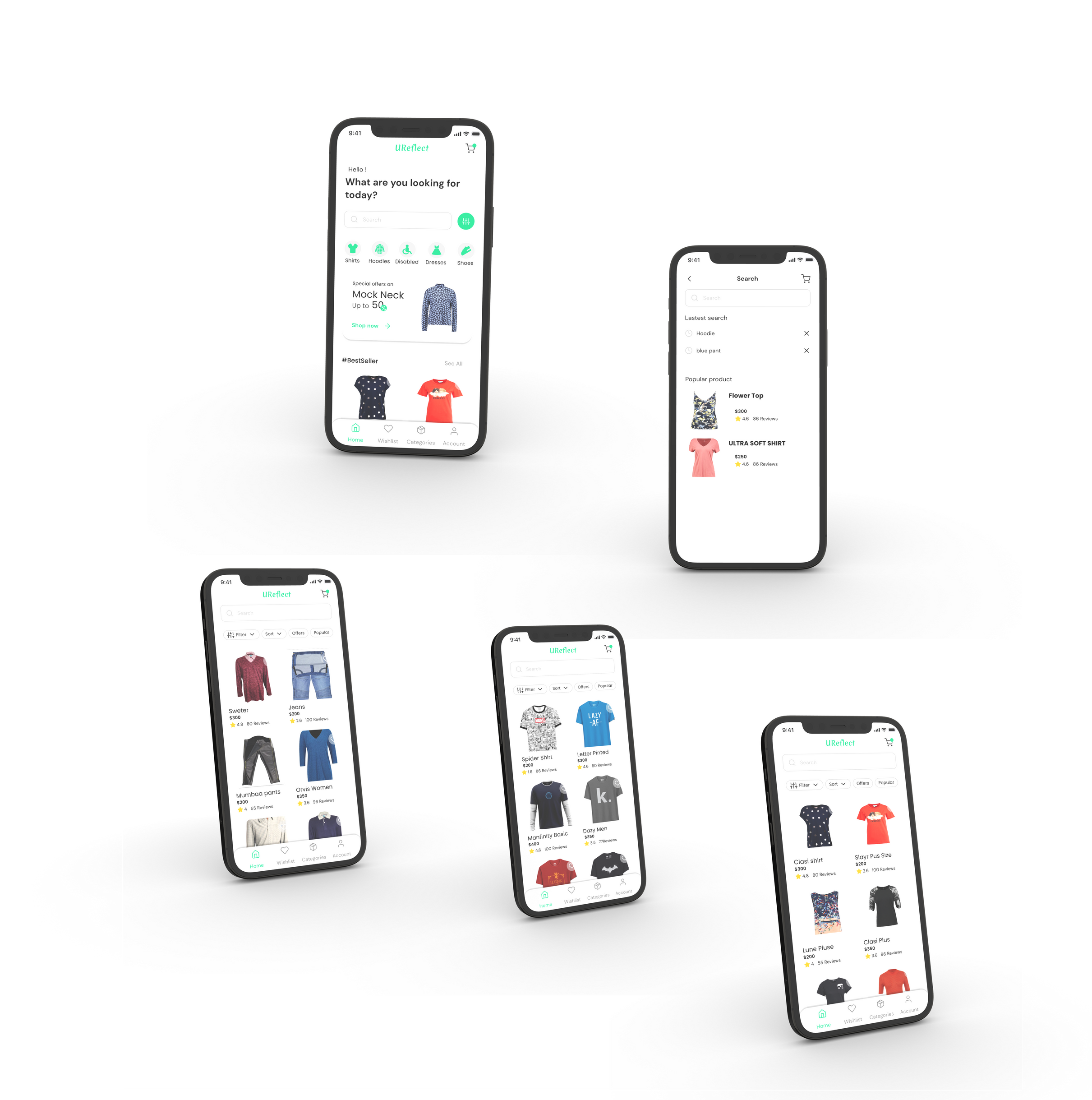

Slide 20
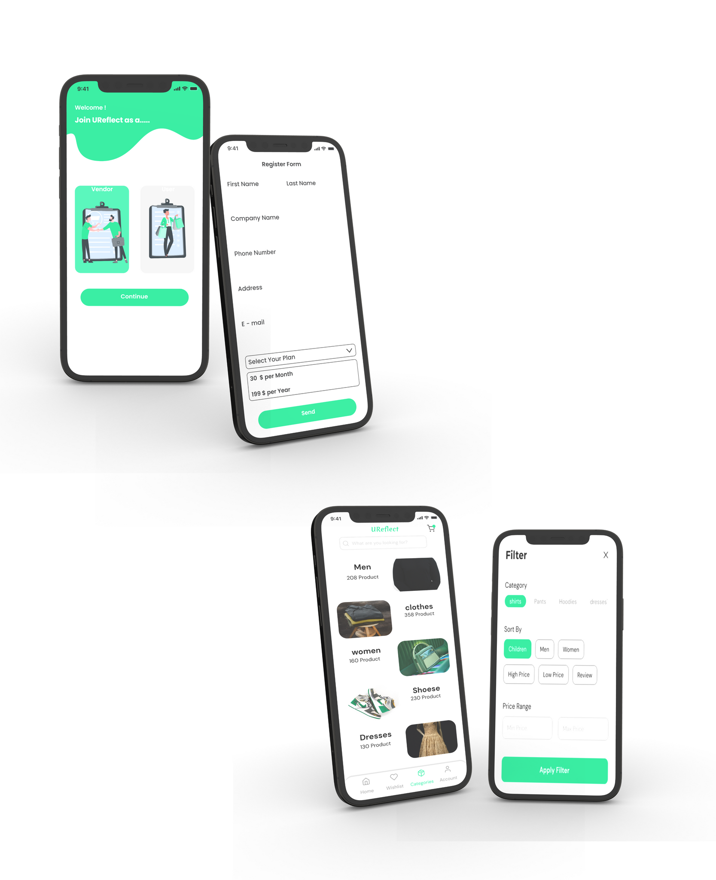

Slide 21
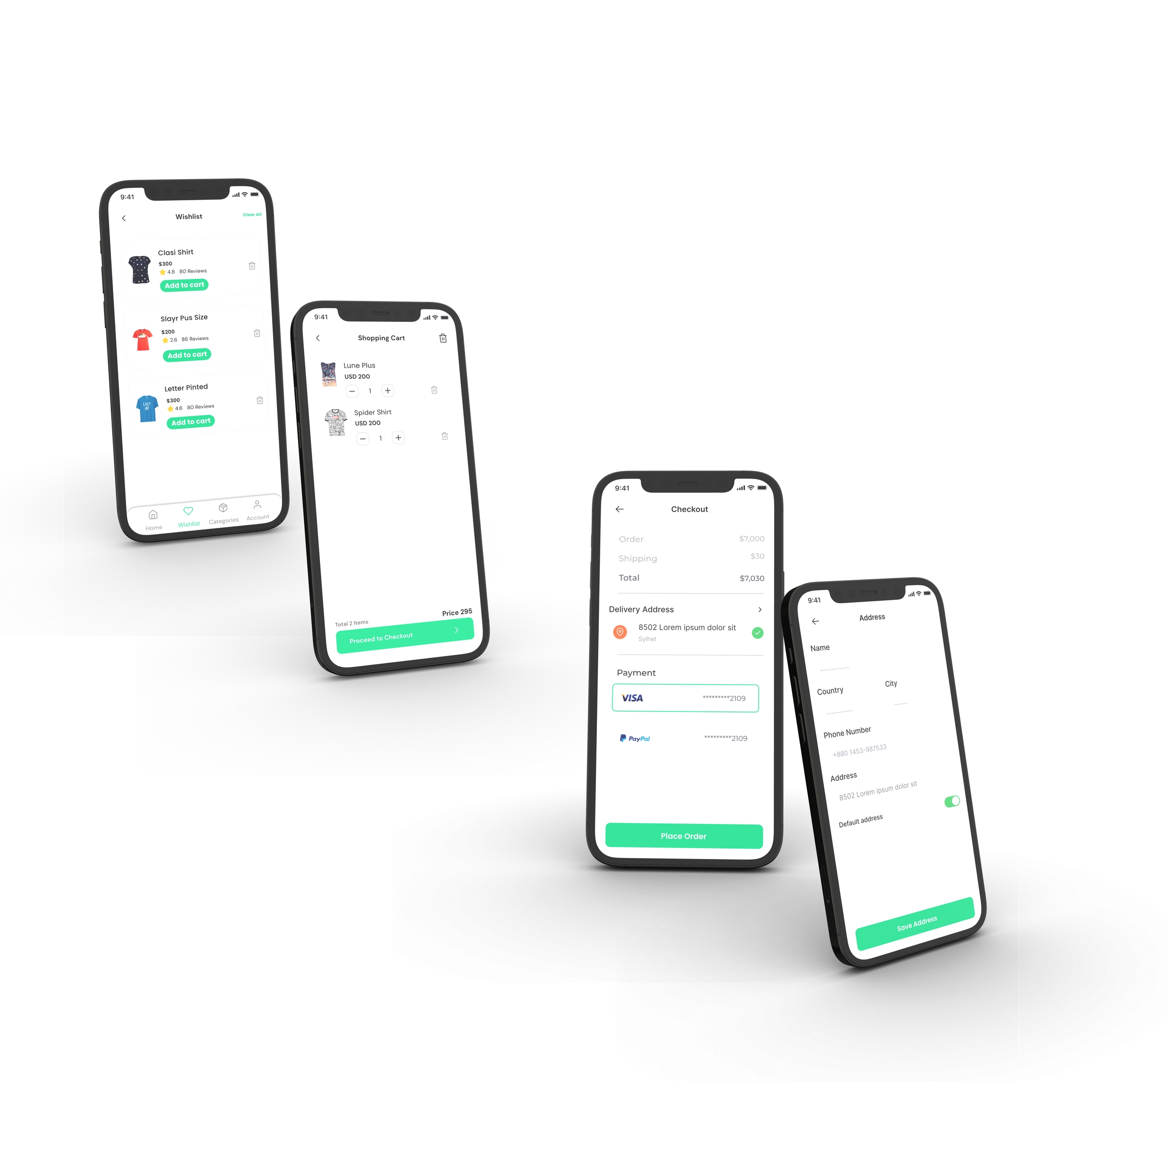

Slide 22
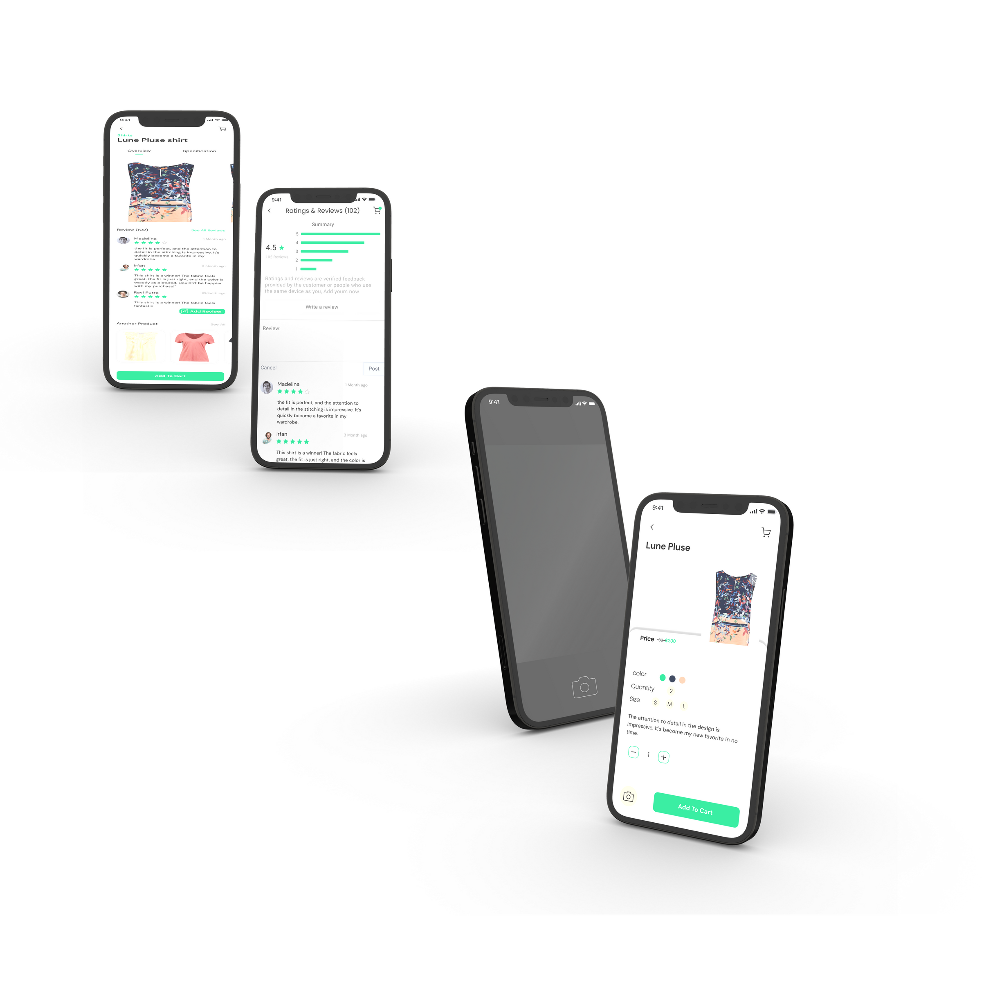

Slide 23
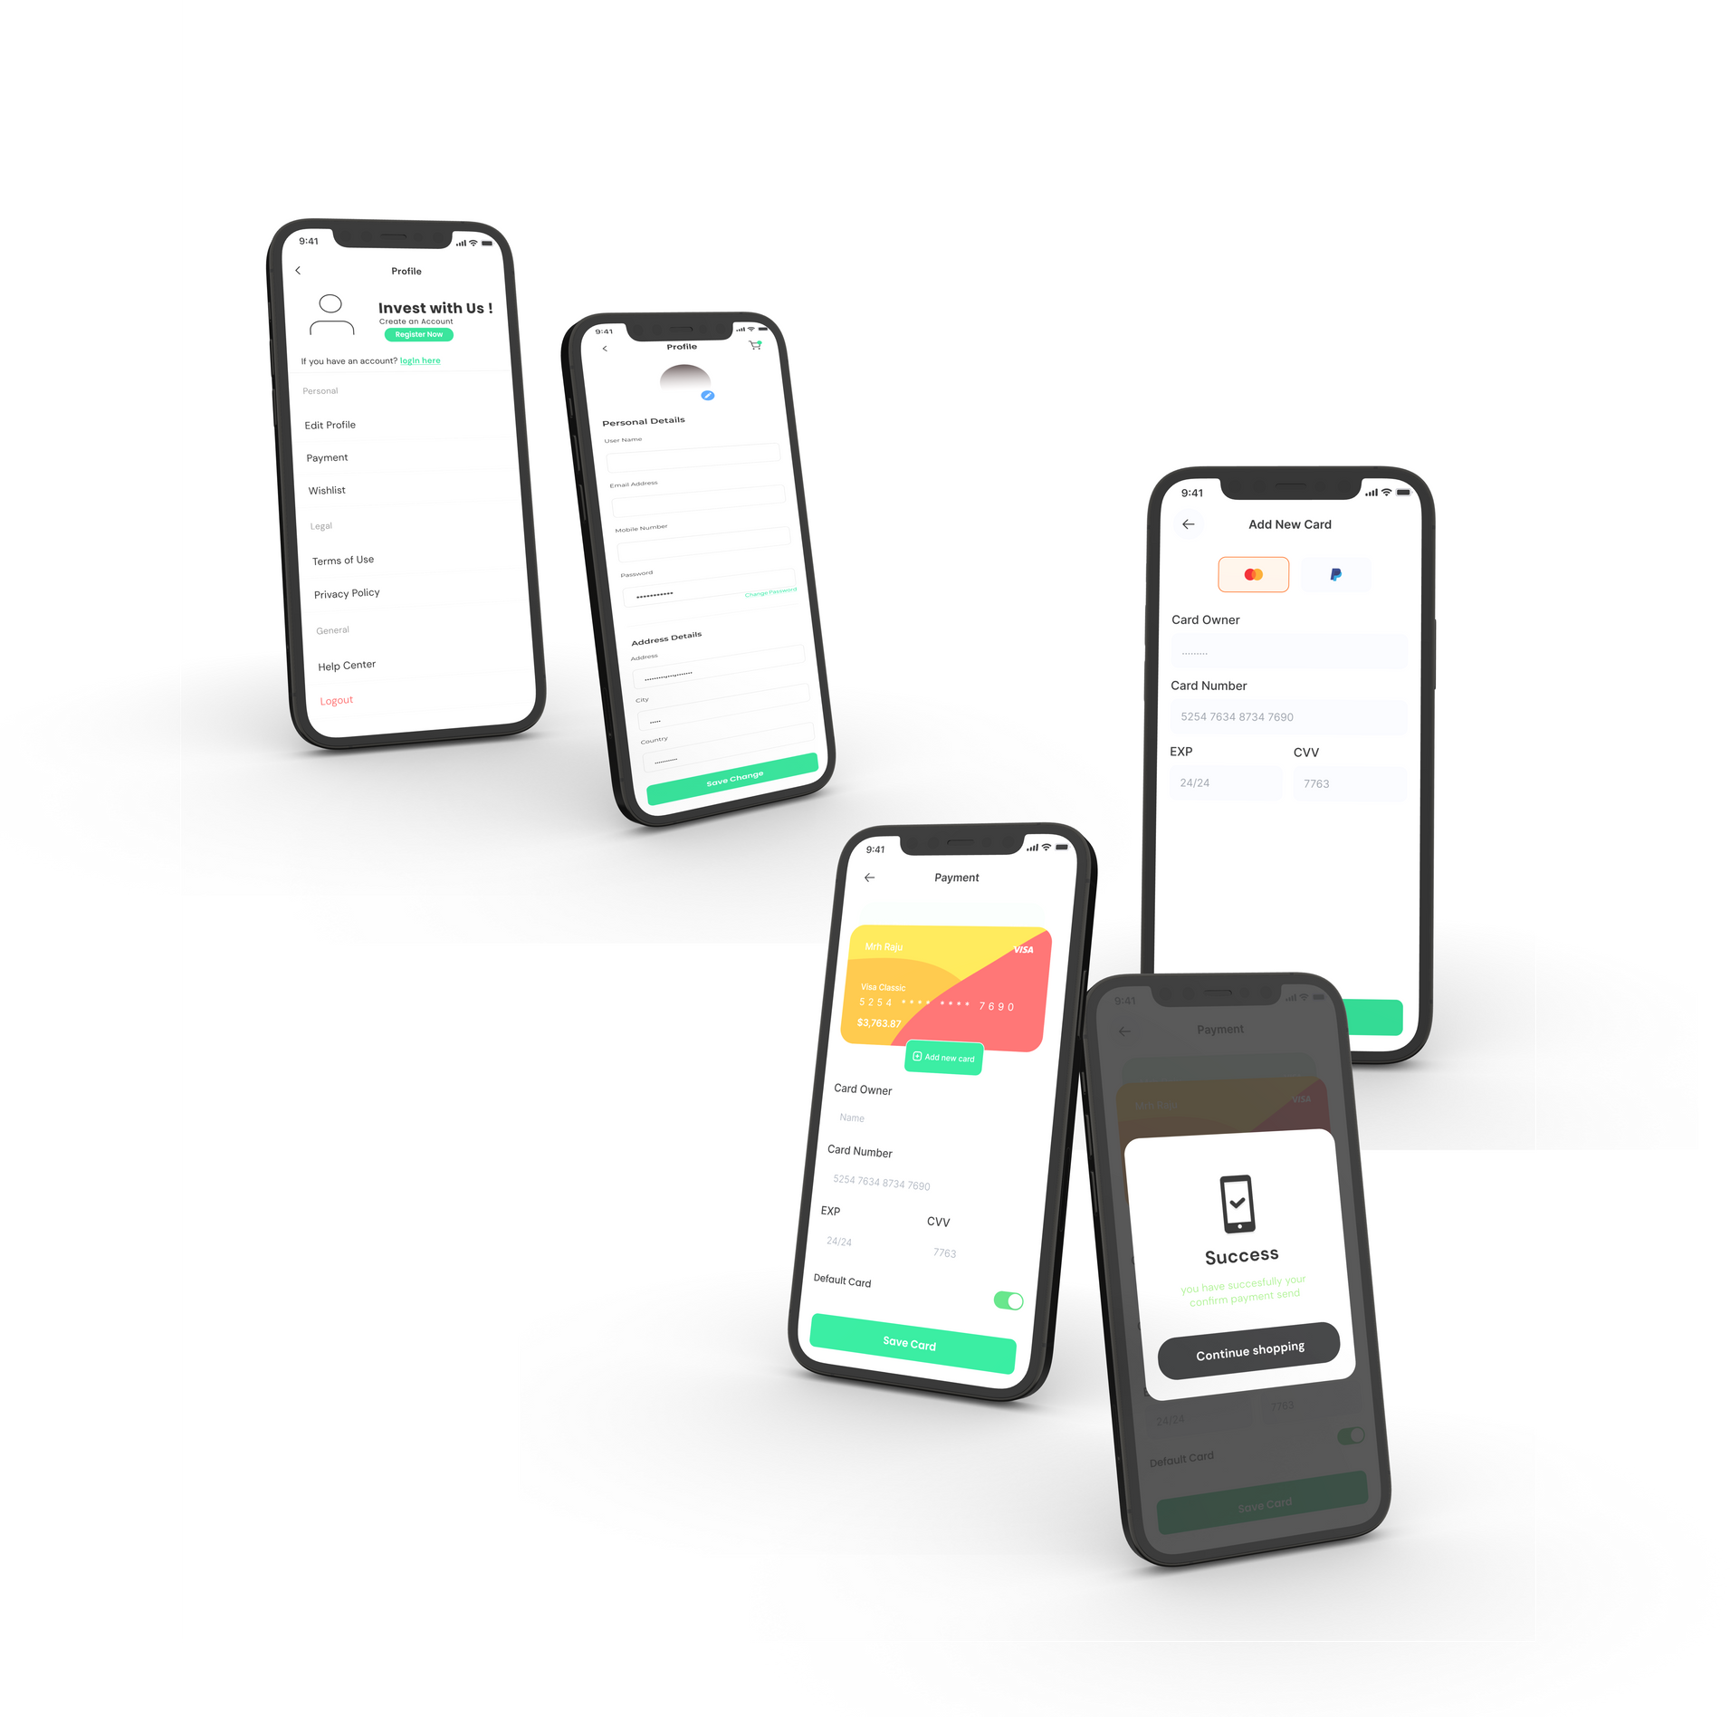

Slide 24

UML
DIGRAM

Slide 25
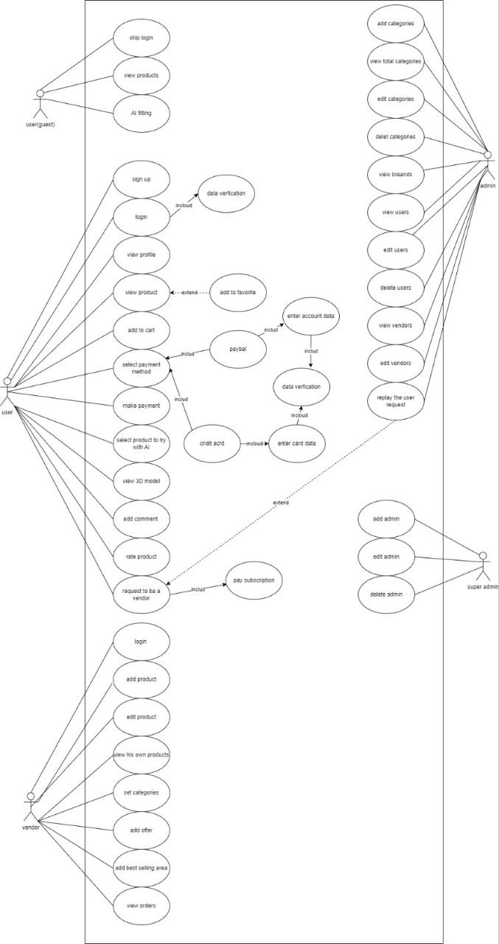
High Level Use case

Slide 26
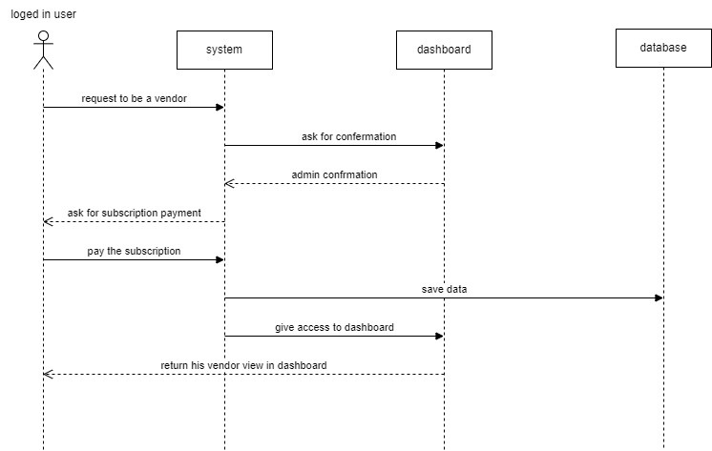
High Level Sequence case

Slide 27
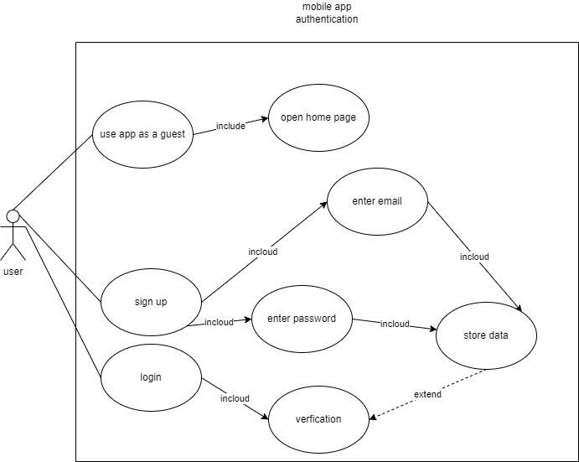
Mobile App Authentication

Slide 28
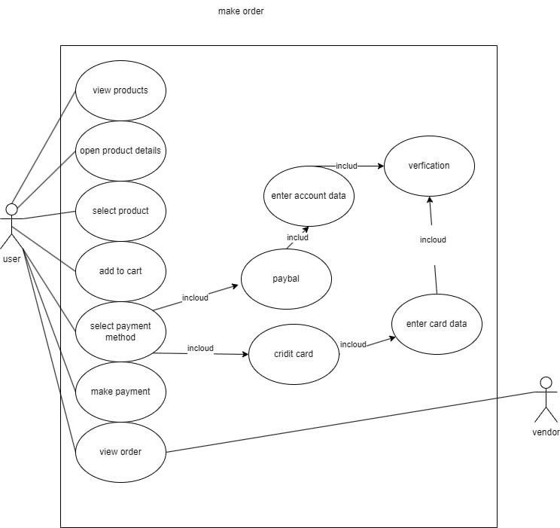
Make Order

Slide 29
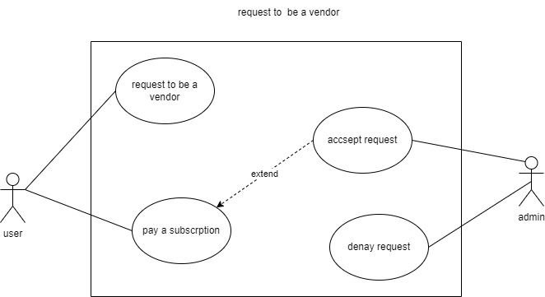
Request To Be A Vendor

Slide 30
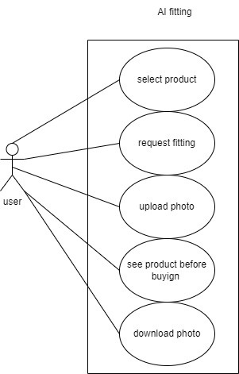
AI Fitting

Slide 31
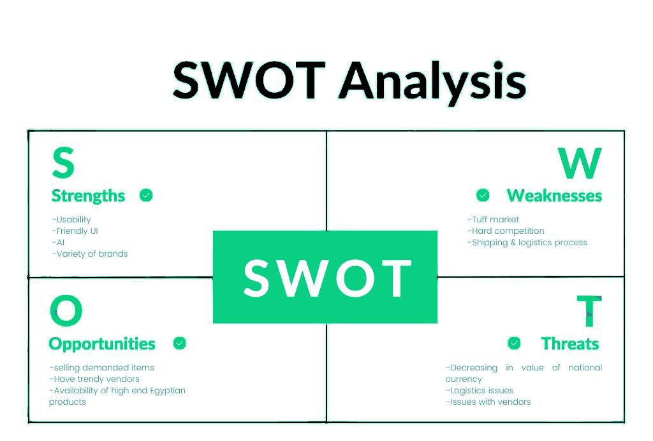

Slide 32
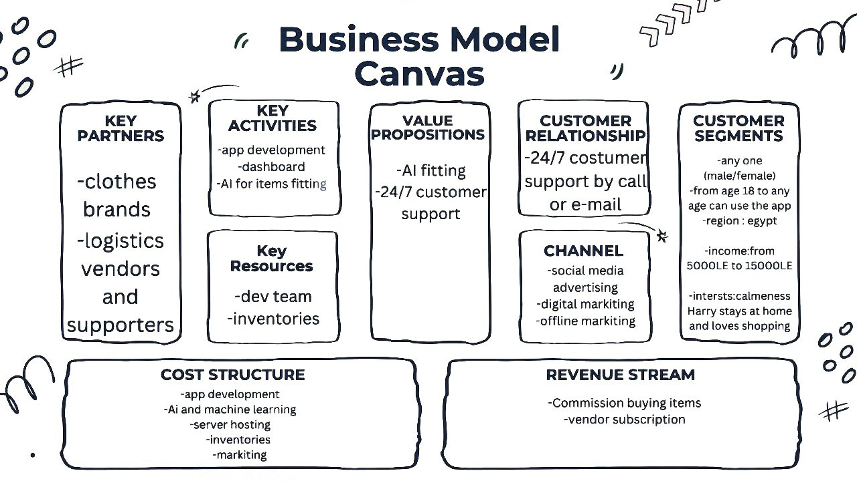

Slide 33
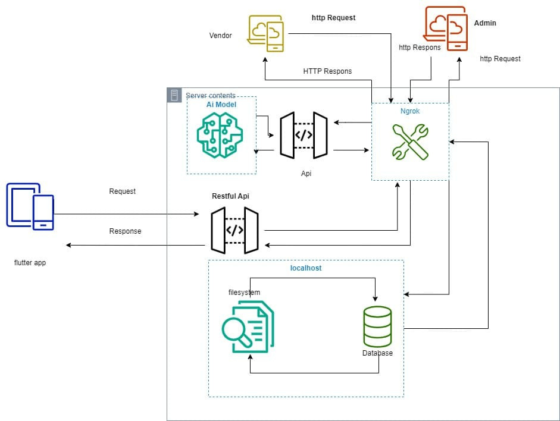
System Architecture

Slide 34
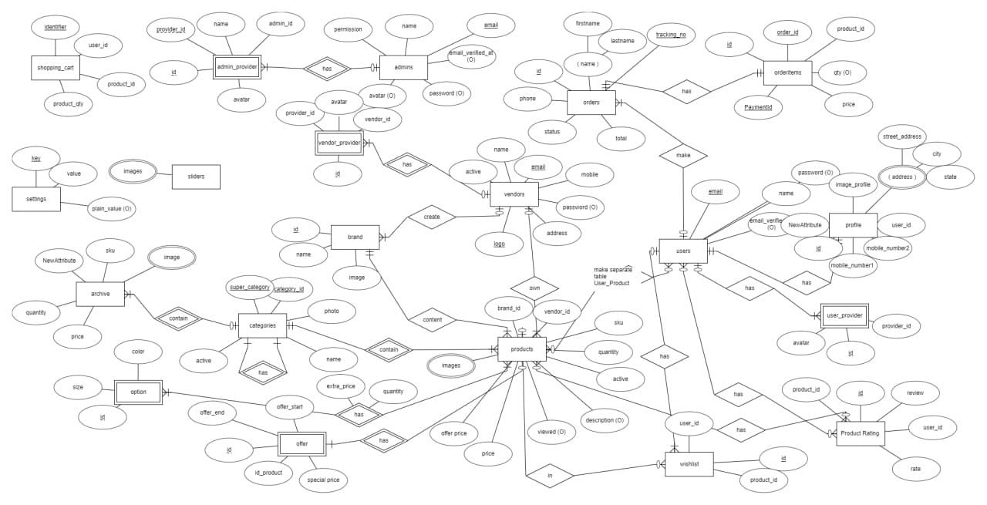
ERD

Slide 35


TOOLS
MOBILE APP
BACKEND
Dart
Flutter
Postman
PHP
MYSQL
Laravel
livewire
Bootstrap
Twilind
Postman
AI
Pytorch
Openpose
Cmake
Postman
Flask
UI AND BUSSINESS
Figma
illustrator
Draw.io
Canva

Slide 36
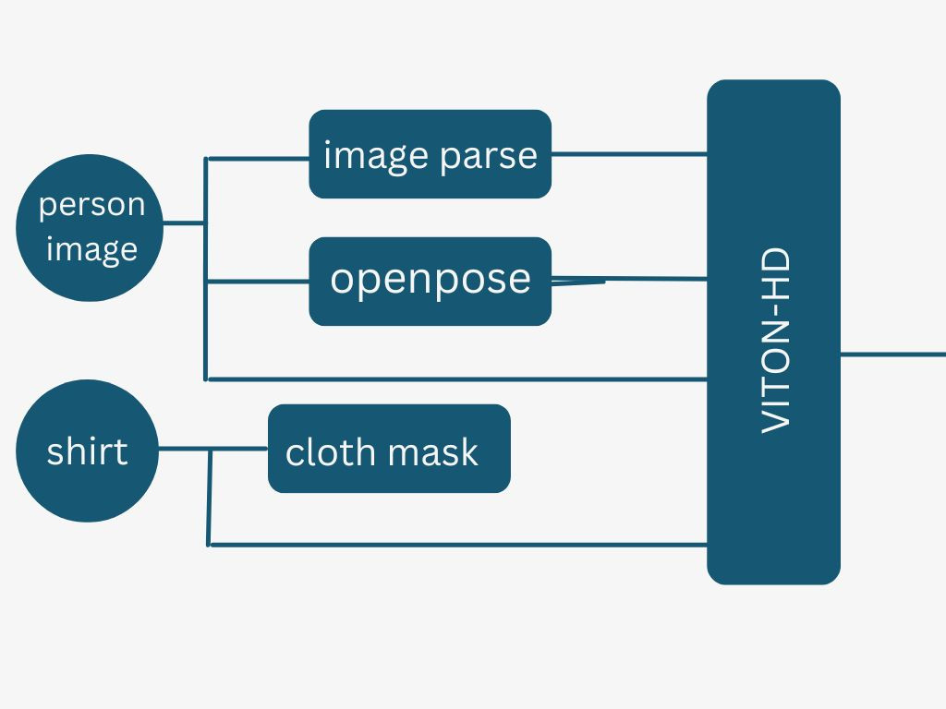
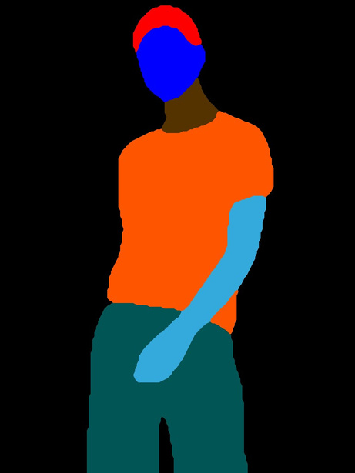
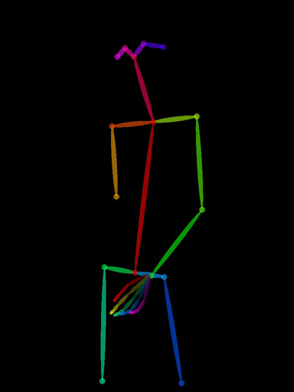

Model Componants
image parse
openpose
cloth mask

Slide 37
TIME PLAN

Slide 38
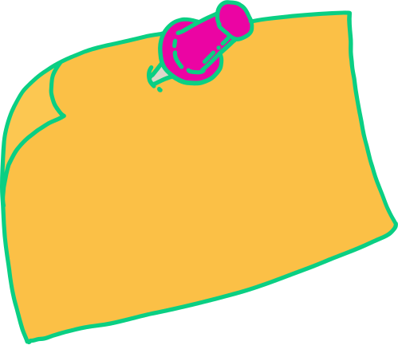

TIME PLAN
TIME PLAN
01
02
03
04
Septemper&October
Novamber&December
Jenuary&February
March&April
Define project requirements and objectives, research e-commerce platforms and AI models
Prepare AI model for virtual try-on clothes,design UI/UX implement vendor panel and admin panel
Implement secure payment gateways and shipping methods, develop mobile application
Integrate AI model with e-commerce platform, develop customer frontend with disabled accessibility features, based on user feedback refine UI/UX

Slide 39
TIME PLAN
04
05
06
May
June
Perform final testing and quality assurance, deploy platform, gather user feedback
Officially launch platform, monitor
performance and user engagement, improve accessibility

Slide 40
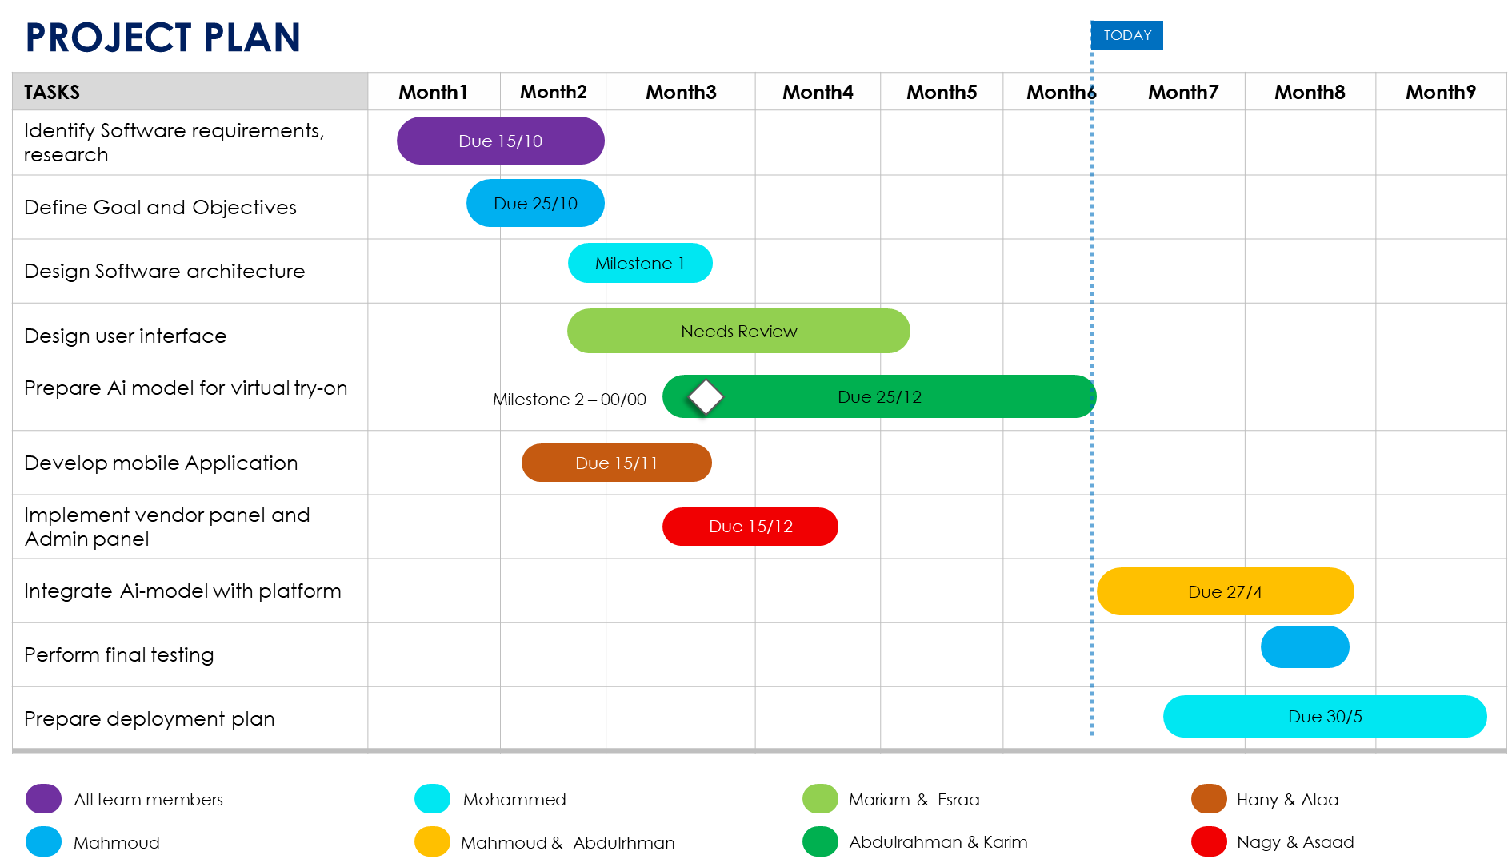

Slide 41
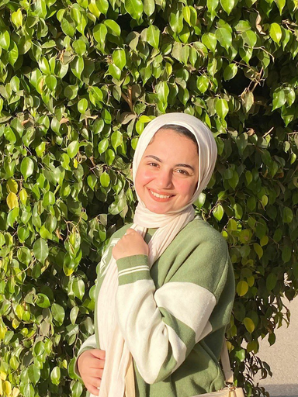
OUR TEAM
OUR TEAM

Slide 42
OUR TEAM
OUR TEAM

Slide 43
OUR TEAM
OUR TEAM

Slide 44
OUR TEAM
OUR TEAM

Slide 45
REFERENCES

Slide 46

REFERENCES

Slide 47
REFERENCES

Slide 48
THANK
YOU!

